Slide 1
Multiple caffeine doses maintain vigilance, attention, complex motor sequence expression, and manual dexterity during 77 hours of total sleep deprivation
William Killgore, Gary Kamimori
Presented by Can Sozuer

Slide 2
After this talk...
"I need to study into the night for these exams, will a cup of coffee help me?"
"I need to drive at night, will a cup of coffee help me?"

Slide 3
Sleep Deprivation Trivia
30% of US workers get <6h sleep
Sleep deprivation can affect or lead to:
  Various cognitive deficits
  Decision making
  Interpersonal relationships
  Operational errors
  Traffic accidents
  Aviation accidents
Simple and repetitive activities more likely to show SD related impairments
Previous studies have not explored effects of SD on simple, repetitive, and monotonous tasks
Previous studies have not considered >500ms attentional lapses

Slide 4
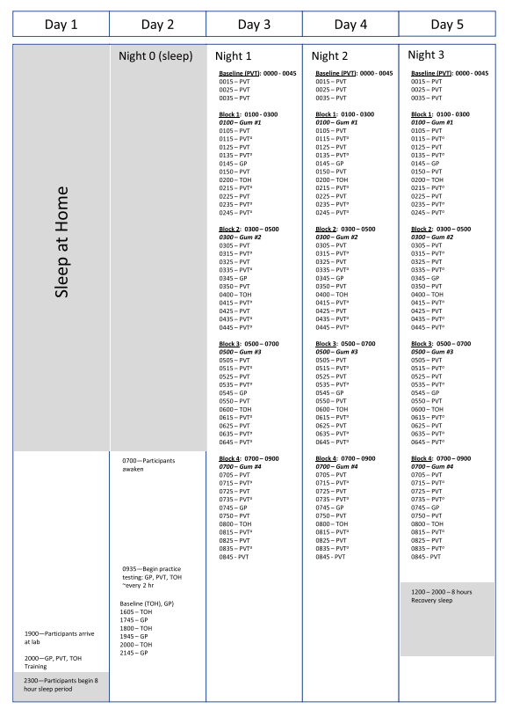
Experimental Design
Initial 8 hour sleep
Baseline measurements following sleep
Sleep deprivation follows baseline measurements
3 days / 77 hours of total sleep deprivation
Measurements taken at night
Experimental Measures
Psychomotor vigilance test
Tower of Hanoi puzzle
Grooved pegboard puzzle
Symptom effects questionnaire
Stanford sleepiness scale

Slide 5
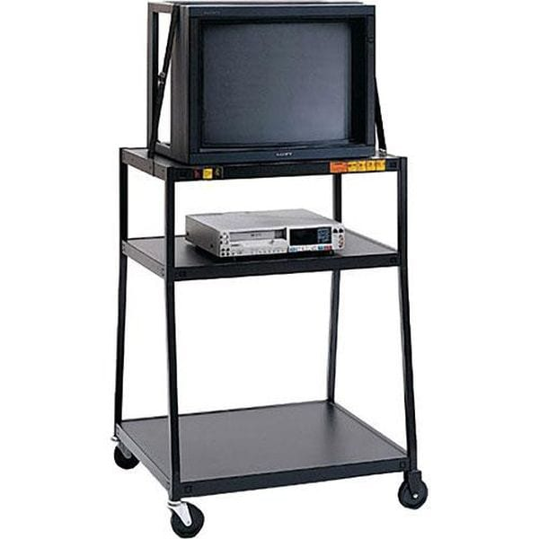

Slide 6
Experimental Measures
Psychomotor Vigilance Test (PVT)
Tower of Hanoi and Grooved Pegboard
Vigilance and attention
People do not get better with practice
Used in sleep deprivation research
Monotonous
Tower of Hanoi:
  Planning moves
  Executing sequence of moves
  6 Peg version
Grooved Pegboard:
  Fine motor coordination
Experimental confounds: Monotony, time-on-task, homeostatic forces

Slide 7
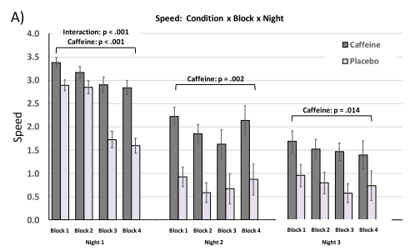
Results
PVT
Speed
Caffeine outperforms placebo on all 3 nights
N_p = .503
Caffeine group more likely to do better than on later blocks only on night 1

Slide 8
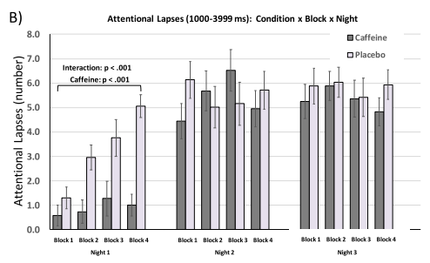
Results
PVT
1-5 second lapses
Auditory intervention
Caffeine outperformed placebo on night 1
Placebo group were more likely to do worse than caffeine at later blocks only on night 1
Night 1 Caffeine N_p = .488
Bonus points for spotting the typo

Slide 9
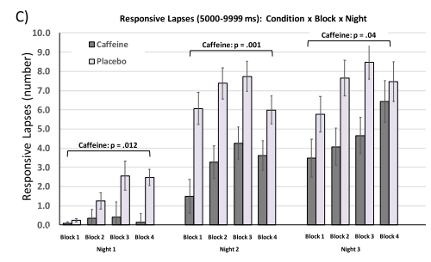
Results
PVT
5-10 second lapses
Physical intervention
Caffeine outperformed placebo on all 3 nights
RL's increased over nights
Caffeine N_p = .335, .519, .239 across the 3 nights

Slide 10
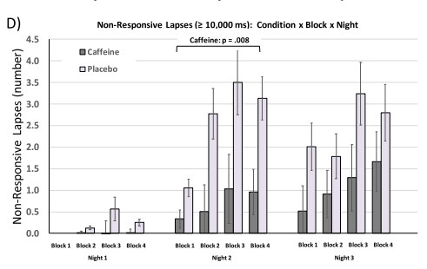
Results
PVT
Non-responsive lapses
General worsening over nights
Caffeine better only on night 2
Night 2 N_p = .361

Slide 11
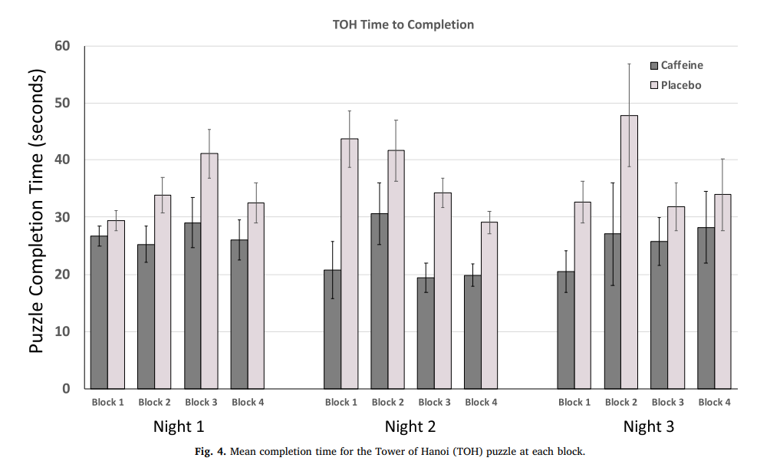
Results
Tower of Hanoi
Completion Time
Caffeine group was faster than placebo (mean 24.91s vs. 35.95s)
Performance did not vary across night or blocks or blocks and nights
On the 6 ring version:
  Caffeine performed better
  Mean 114 moves vs. 165
  N_p = 0.200
N_p = .379

Slide 12
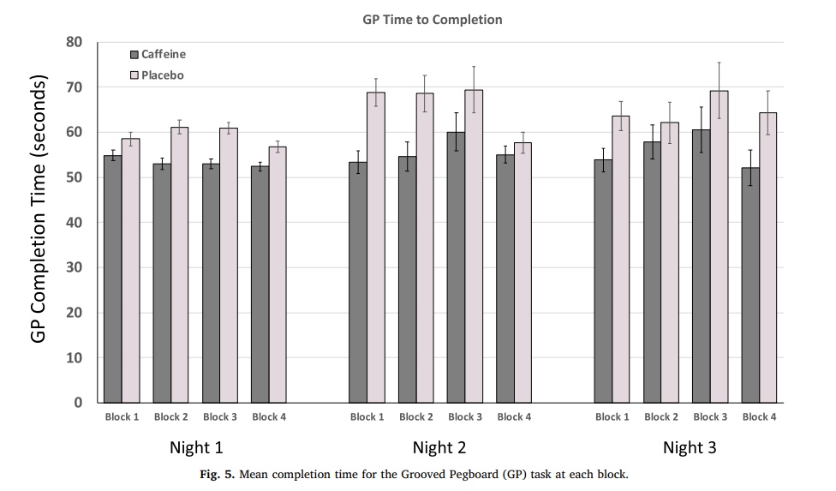
Results
Grooved Pegboard
Completion time
Caffeine group faster than placebo across all 3 nights
Performance did not differ between nights, blocks, or nights and blocks
N_p = .326

Slide 13
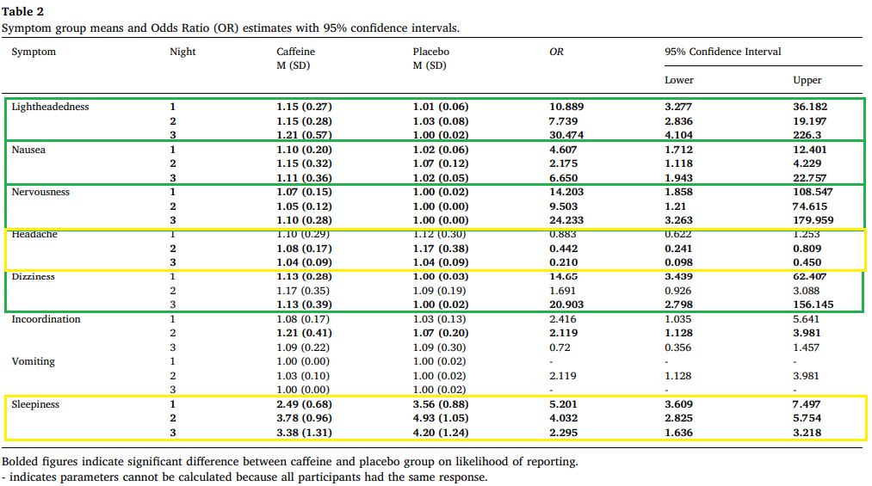
Side Effects: Caffeine did worse. Placebo did worse.

Slide 14

Results
Stanford Sleepiness Scale
Sleepiness

Slide 15
Multiple caffeine doses maintain vigilance, attention, complex motor sequence expression, and manual dexterity during 77 hours of total sleep deprivation
William Killgore, Gary Kamimori
Presented by Can Sozuer

